Slide 1
Social Performance & Environment
Kawien Ziedses des Plantes, Deputy director SP,CB&Env
Brussel, 13 mei 2017

Slide 2
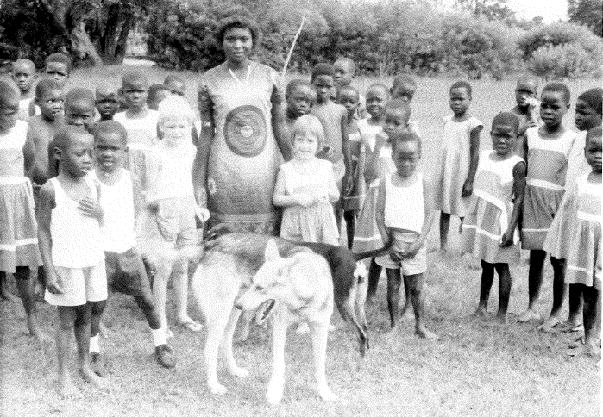
Kenia

Slide 3
Oikocredit UA - kerncijfers
 | 31-12-2016 | 31-12-2015
Beleggers wereldwijd | 54.000 | 51.000
Uitstaande projectfinanciering | € 1.047,2 mln | € 900,2 mln
Uitleenbare fondsen | € 1.018,5 mln | € 899,5 mln
Portfolio at risk (PAR 90) | 4,5 % | 5,3 %

Slide 4
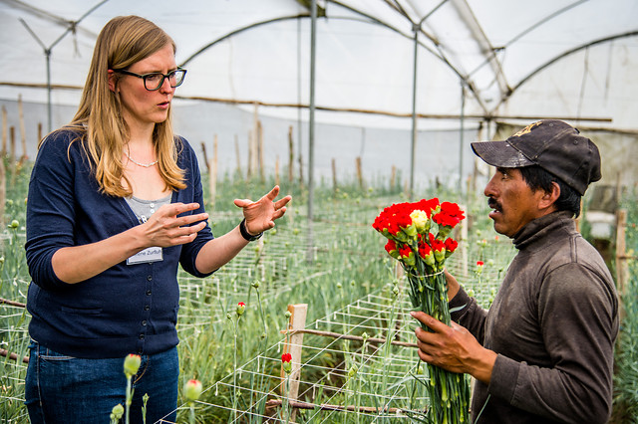
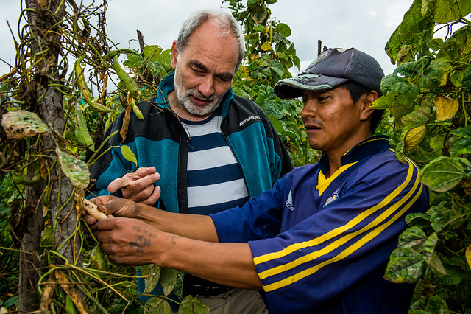
Belangrijkste mijlpalen 2016
Uitstaande projectfinanciering:
meer dan € 1 miljard
Netto-kapitaalinstroom:
€ 94,3 miljoen
Capacity building:
€ 490.000

Slide 5
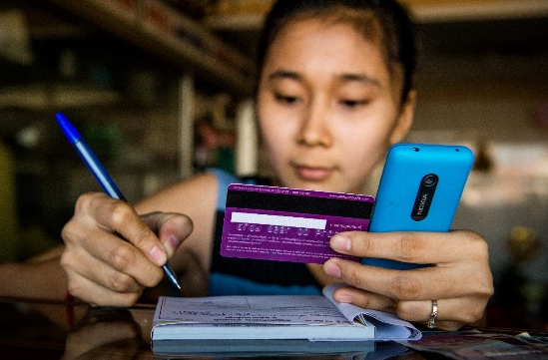

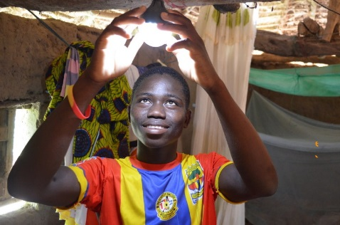
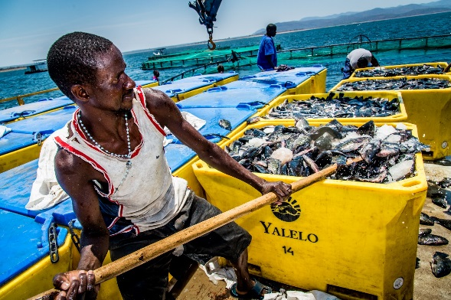
Strategische focuspunten
Inclusieve financiering
Landbouw
Hernieuwbare energie
Afrika

Slide 6

Oikocredit & SDGs – werelddoelen
Welk doel zou er nog bij kunnen?
Ja, bij number 12: VERANTWOORD BELEGGEN!!!
Notes:
As I look at these 17 goals I recognise Oikocredit in many of them. Some certainly more than others, but there are few which I’d say have nothing to do with Oikocredit.
I’d like to think that if we (a group of Oikocredit investors and likeminded people like you) had gotten together, we would probably have come up with a similar set of goals.
When you look at the SDGs, is there’s anything missing though?
[Audience will suggest some topics which they think are missing]
I was struck by SDG number 12 and wondered why “responsible investing” is not included.
Financial inclusion is specifically mentioned in the 169 underlying targets of the SDGs, explicitly linking it with 6 of the SDGs. How you achieve financial inclusion is key – It should be done responsibly.

Slide 7

Verantwoord beleggen
Wat willen we bereiken?
Hoe maken we deze doelstellingen meetbaar?
Wat doen we met de resultaten?

Slide 8
Verantwoord beleggen
Begint bij selectie
Criteria oa ESG Scorecard
Onderzoek & analyse
ESG scorecards
Leren
Capacity building – the plus to finance
Toezicht houden, rapporteren indicatoren en uitkomsten
Notes:
We are unique not only because of how we have developed and because of the role played by volunteers. We are unique because we remain mission focused and have developed a strategy and approach to ensure that people and improving their lives remain at the center of our work. That is our SPM strategy.
Our partners often face more than just financial challenges. Skills shortages, knowledge gaps or missing certifications can be obstacles to achieving financial and social goals. While Oikocredit’s core business is finance, we offer capacity building programmes so our partners can operate more efficiently and effectively – and we can go a lot further in fulfilling our own mission.
A significant portion of Oikocredit’s portfolio will necessarily be in organizations with potential for improved financial and social performance;
In addition to choosing the right partners, Oikocredit is also challenged to motivate, assist and strengthen partners’ capacity in enhancing their performance so that end clients are benefitted as much as possible. This is the broad context within which Oikocredit’s offer of support in Capacity Building is located.

Slide 9
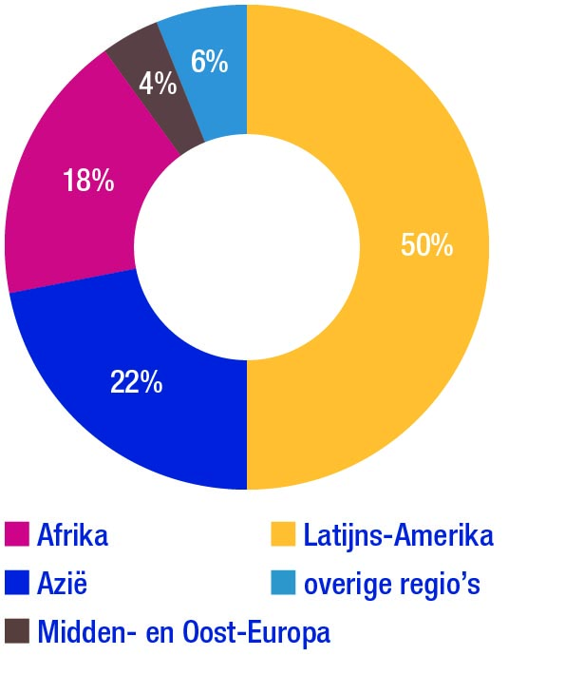
Waar financiert Oikocredit?
31 december 2016

Slide 10
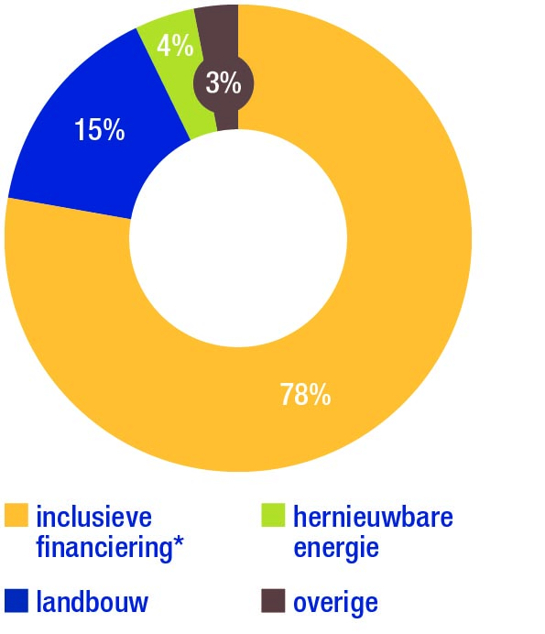
Welke sectoren?
31 december 2016

Slide 11
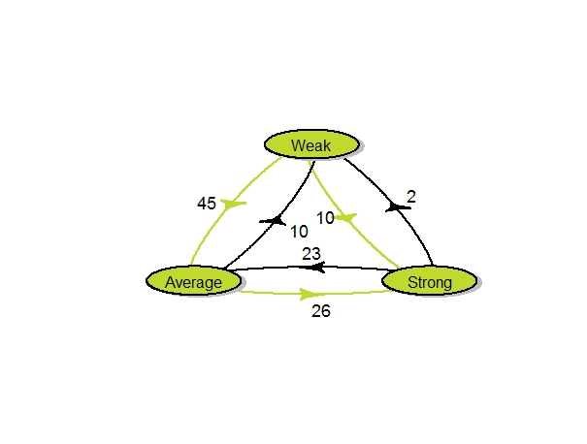
Waarschijnlijkheid (%) van verbetering in 5 jaar van ESG score van FI partners
ESG = Environment, Social, Governance
Doel is om onze partners te versterken
Notes:
Note: sample of 162 observations, between 2010 and 2015. Weak: ESG 0-55%, Average: ESG 56-65%, Strong: ESG >65%
Figure 10 shows the probabilities of partners to transition to from one ESG category to another in the following time period. The green lines show an overall positive development, i.e. a probability to improve in ESG score. For instance, partners had 45% probability to upgrade from a Weak ESG score to the Average category. With a probability of 26%, partners moved up from an Average to a Strong ESG score and with a probability of 10%, from Weak to a Strong score. Overall, the likelihoods of partners to increase in category are consistently larger than the likelihoods to decrease in ESG score category. This implies that the ESG scores of our partners are increasing over time. Something that we need to investigate together with the regions are those cases that transition from a Strong to a Weak score. Luckily the probability for partners is low (2%) but it implies that over time a some of our partners have made that transition.

Slide 12
Social performance indicatoren
 | 2015 | 2016
Klanten van Oikocredit’s microfinancierings partners | 46 million 5,9 million | 40 million 5,6 million | Groot deel India Naar rato van Oikocredit’s financiering
- vrouw | 86% | 84%
- man | 51% | 48%
Banen (landbouw, overige) | 53.000 | 54.000
Portfolio in Afrika | EUR 158 million | EUR 188 million
Totaal portfolio outstanding in least-developed countries | EUR 140 million | EUR 123 million
Gemiddelde effectieve rente microfinancieringsklanten APR MFIs charge their clients | 36% | 34.8% | CGAP (Wereldbank): global average 35%

Slide 13
Doelgroep capacity building activiteiten
Oikocredit
Coops
Bedrijven
Non profit organizaties/NGOs
Financiële Instellingen
Boeren
Klanten/Boeren
Klanten/Boeren
Klanten
Niveau 1
Niveau 2

Slide 14
1. Client Outcome Program: meten=weten
Technische assistentie microfinancieringspartners om hun data te analyseren.
Doel: effect van leningen op eindklanten.
50 MFIs in 2020 en 3 academische onderzoeksrapporten.
Paper: ‘Effects of microcredit on the poverty of borrowers using the PPI: Evidence from 2 Asian MFIs’ (Jain, Gravesteijn, Hoepner, 2015) oikocredit.coop/client-outcomes
Notes:
Oikocredit actively promotes the PPI with Grameen Foundation 2008-2013 (poverty)
Key results of the program
PPI was successful in measuring poverty outreach of borrowers
Reported being a user-friendly tool that is intergraded in MIS
However, most MFIs did not track client’s ‘progress out of poverty’ or other changes in client lives (job creation, income generation)
Challenges in using client data for credit operations, product development, and performance management.

Slide 15
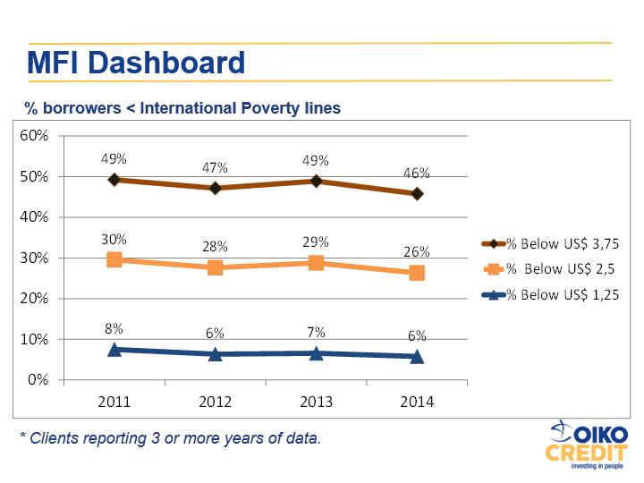
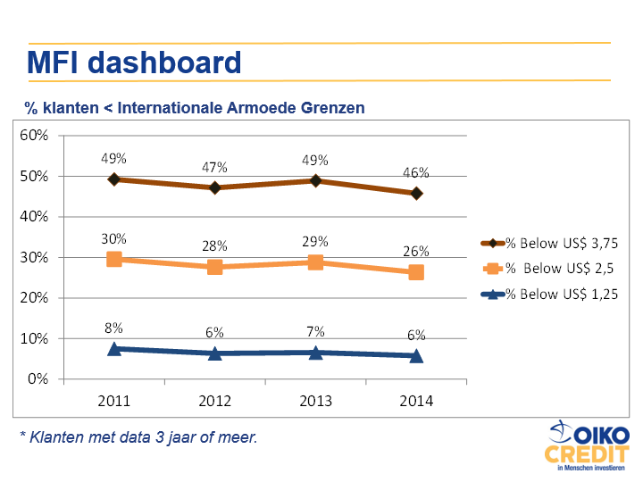
MFI dashboard
% klanten < Internationale Armoede Grenzen
* Klanten met data 3 jaar of meer.

Slide 16
2. CB FS: financieel onderwijs
Voorbeeld:
510 community leaders en 9 lessen voor 270 klanten buiten de stad
20.400 leden getraind
Leren sparen, financiën van huishouden en kleine ondernemingen
Notes:
We also facilitate support to clients or members of our project partners. This was the case in Vietnam where we supported the financial literacy training for clients of our MFI partner, TYM. This training was launched in response to what was seen as a growing problem of over-indebtedness among clients.
The work that we do in capacity building complements our financing work. It is driven by a realization that poverty is not solved by just having more money in the hands of people. We need to support people in the effective use of resources so that the money that we make available helps them to improve their lives rather than create problems of repayment.
Our capacity building program runs to around 2 million euros per year. The capacity building program that we run makes a real difference in the success or failure especially of those partners who work with the poorest populations. It is something which sets Oikocredit apart from other investors.
How is this program sustained and funded? A certain amount is donated out of the profits of Oikocredit. You as members and investors can also participate in supporting this capacity building program through donations and that would be most welcome!
Thank you!

Slide 17
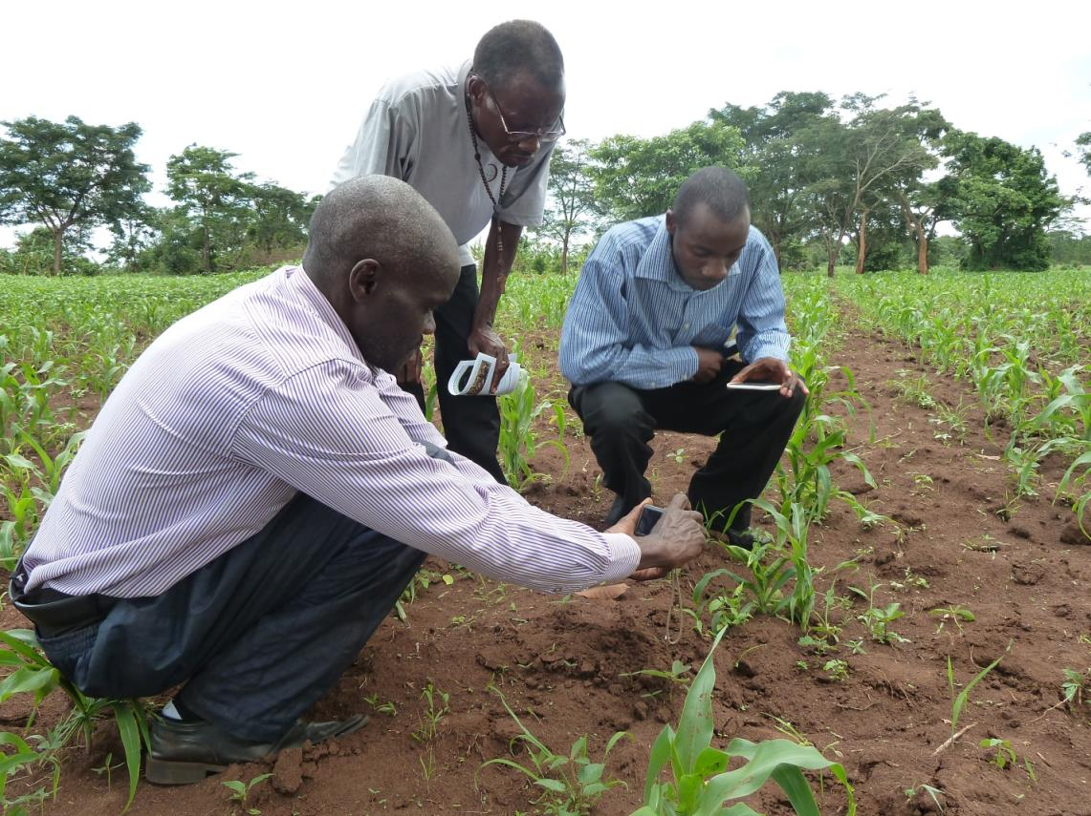
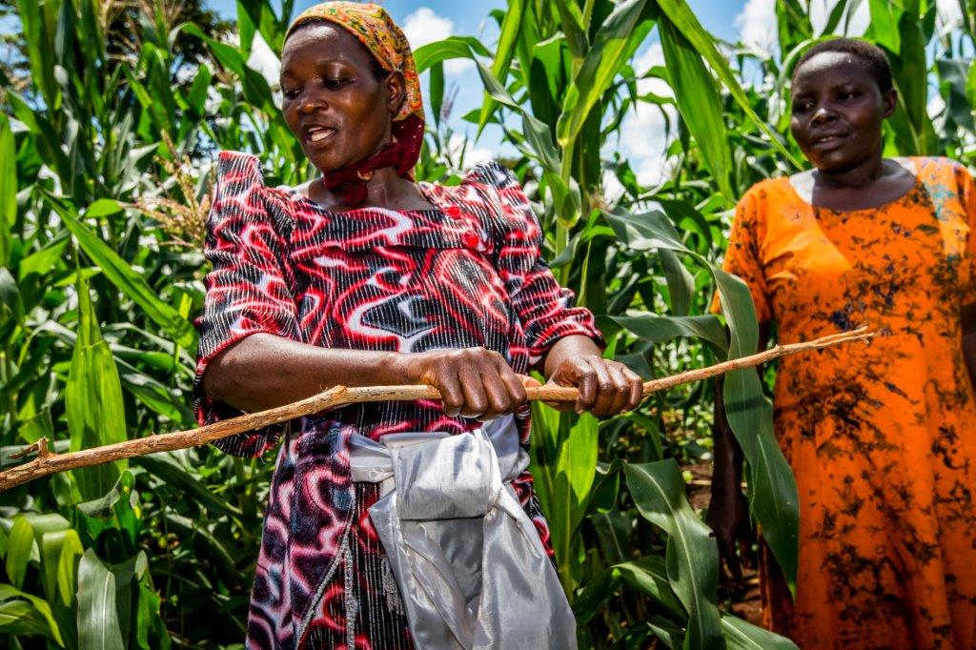
3. CB Landbouw: training boeren/coops
.
in Uganda
Farmer Based Incubation programma in Uganda

Slide 18
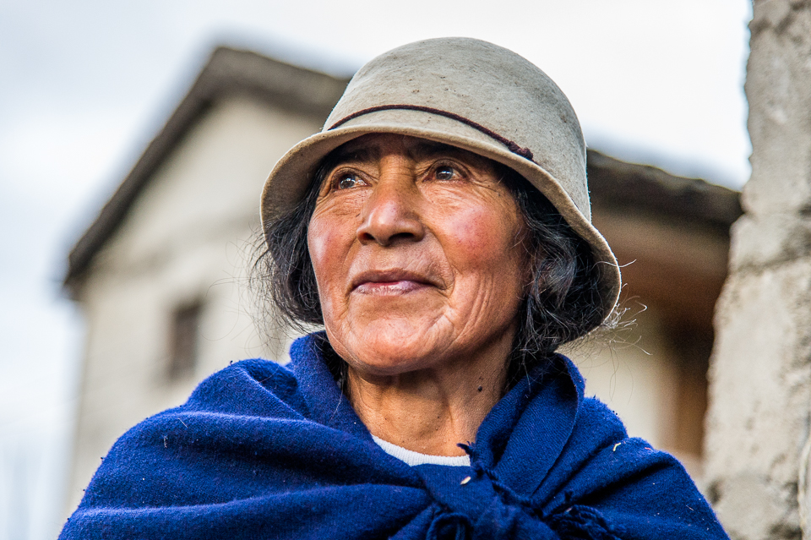
Vooruitblik
Doel voor 2017: 10% groei van portefeuille
Meer capacity building programma‘s

Slide 19


Wat zijn onze waarden?
Gelijkheid
Solidariteit
Grassroots
Integriteit
Environment

Slide 20

Bedankt!

